Slide 1
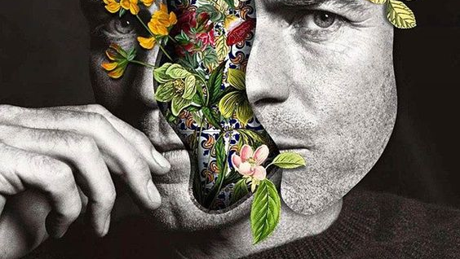
Interior vs exterior

Slide 2
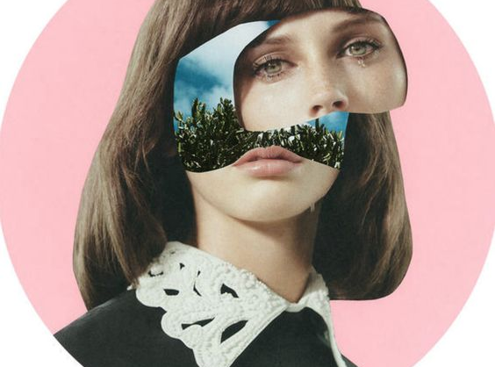
Your assignment
You will create a surrealist portrait based on the theme of our exterior selves versus our interior selves.
This portrait is meant to be a surrealist interpretation, and therefore unrealistic.
This assignment can be any medium of your choosing – including collage from magazines or internet images (must be high quality).
This assignment should be a collage of images to represent the way our exterior selves often hide what we really feel underneath.
This may be a self portrait, or you may use pictures of models/celebrities instead.

Slide 3
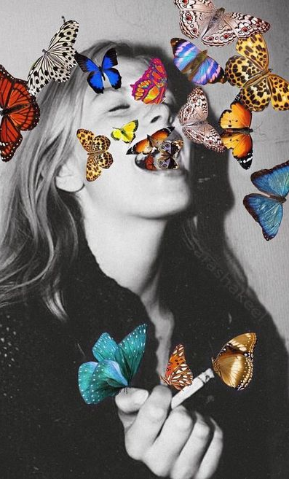
If you are choosing magazine images for your collage…
Choose a photo to be your base (main) image – a model, celebrity, yourself, etc.
Choose other images to cut and paste which will symbolize the inner-self
These inner-self images should be unrealistic, and the overall portrait should feel like a surrealist piece.

Slide 4
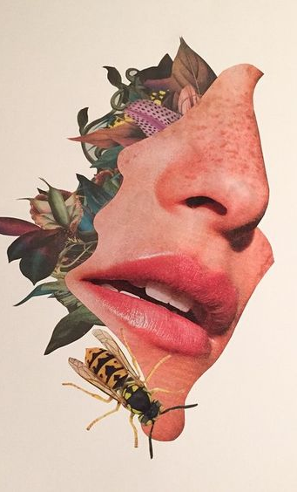
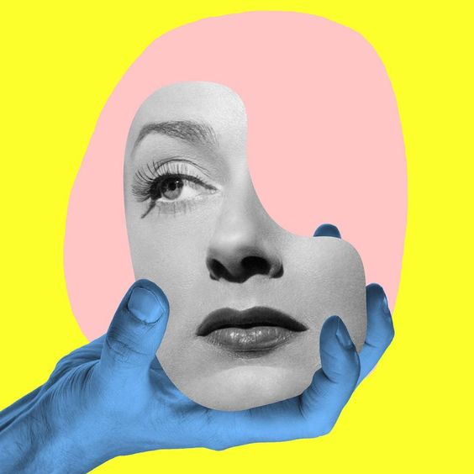
Fragments
Do not incorporate all of the images in the face. Try arranging the images throughout the artwork to create an interesting composition.

Slide 5
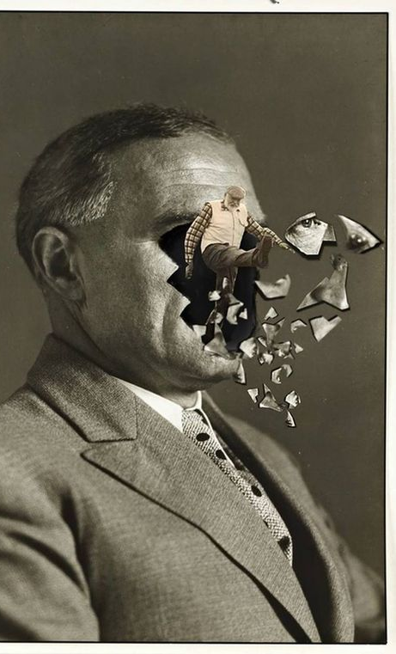
Symbolism
Consider the images you use for the inner-self
How can these images symbolize an emotional or mental state, personality, inner-thoughts, etc.?

Slide 6
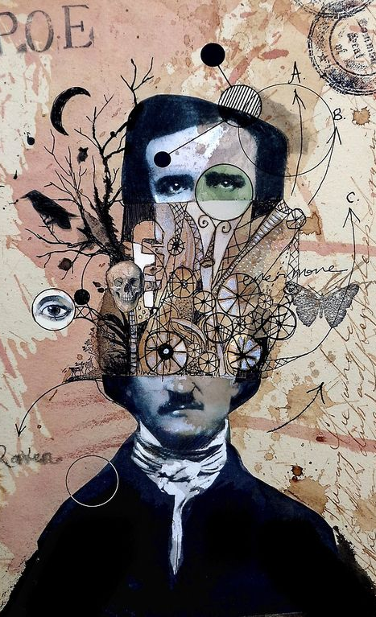
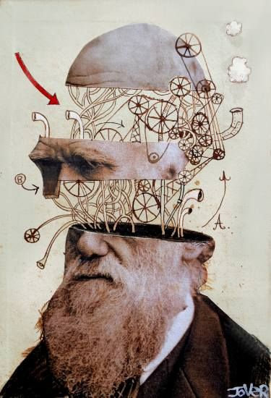
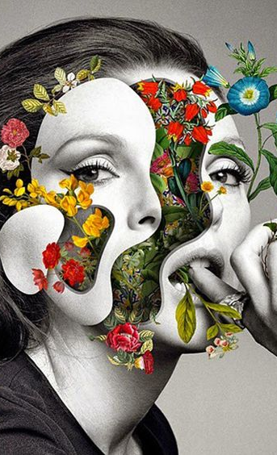

Slide 7
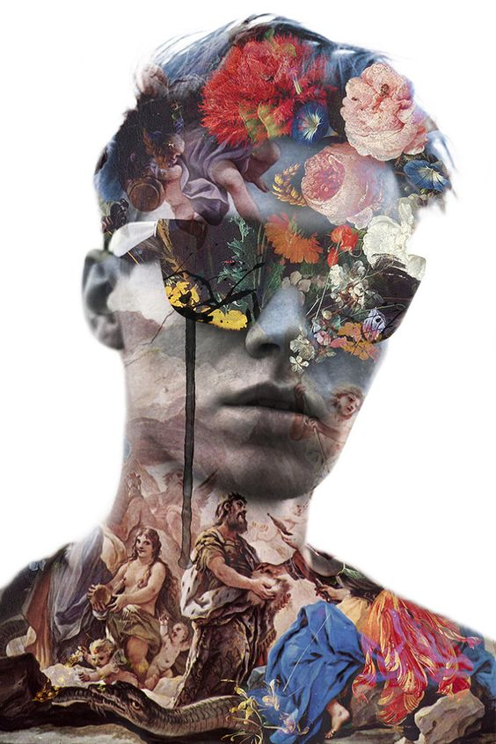
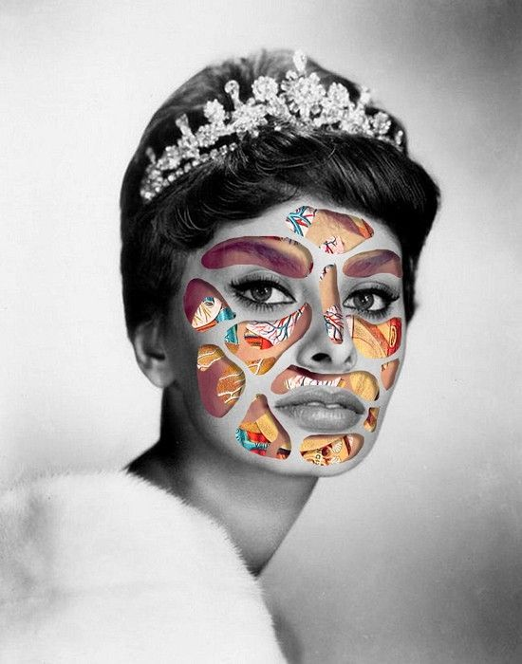
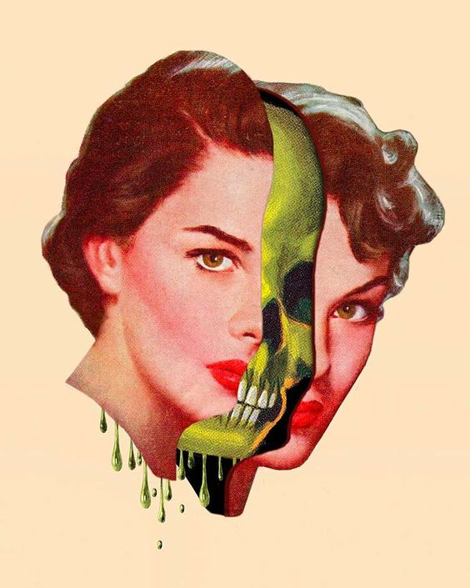

Slide 8
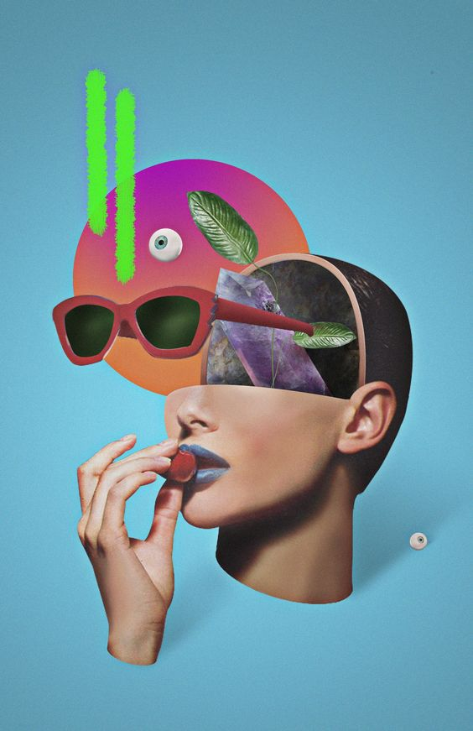
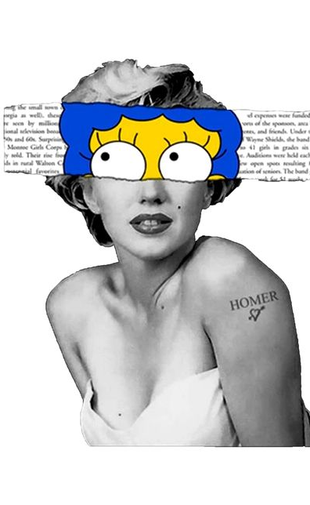
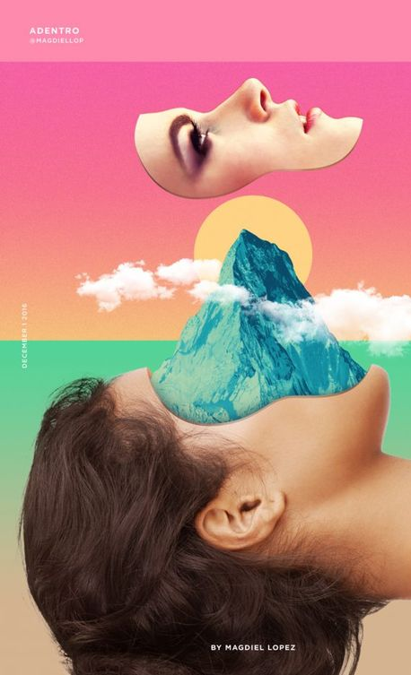

Slide 9
Your assignment
You will create a surrealist portrait based on the theme of our exterior selves versus our interior selves.
This assignment can be any medium of your choosing – including collage from magazines or internet images (must be high quality).
This is your final assignment for Art 25!
This assignment is worth 40 marks.

